Slide 1


Slide 2
Grafana Basics
Overview
Access Grafana UI
Access MAUL Dashboard
Create Dashboard
Export/import Dashboard

Slide 3
Overview
Analytics and interactive visualization tool
Analytics platform for all your metrics
Grafana supports querying Prometheus based on PromQL
Grafana allows you to Query, visualize ,alert on and understand your metrics no matter where they are stored
Used in combination with time series databases such as InfluxDB, Prometheus and Graphite

Slide 4
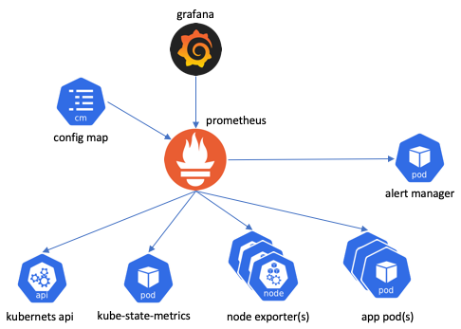
High level Architecture

Slide 5
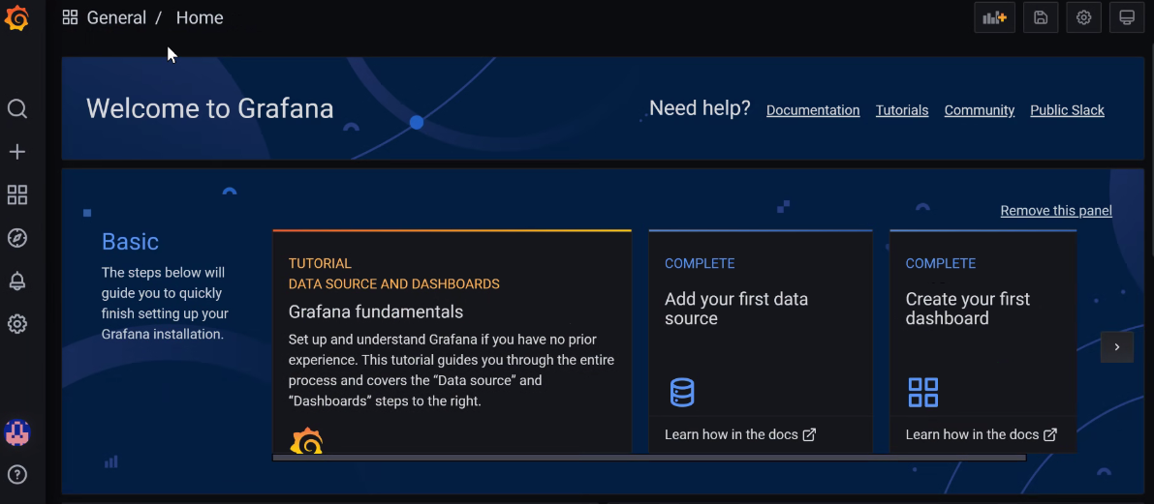
Access Grafana UI
Local: http://localhost:3000/dashboard/new?orgId=1
Test: https://maul-grafana.k8s-test.opr.test.statefarm.org/?orgId=1
Prod: https://maul-grafana.k8s-prod.opr.statefarm.org/login

Slide 6
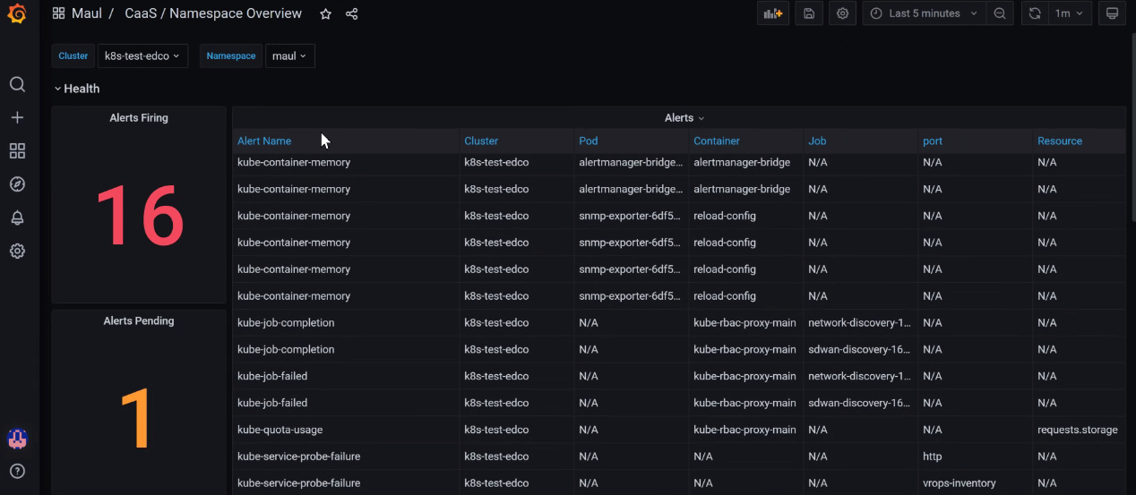
Access MAUL Dashboard (Caas Namespace Overview)

Slide 7
Add Data Source
Steps to configure Data source
Home Page
Setting
Data Source
Select Data Source of Add new data Source
Provide basic detail like
Name
Data source URL
Auth detail if required
scrape interval ..etc
Save

Slide 8
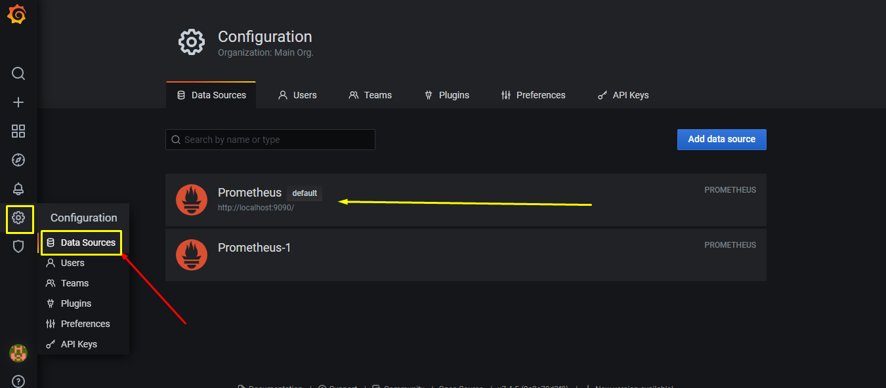
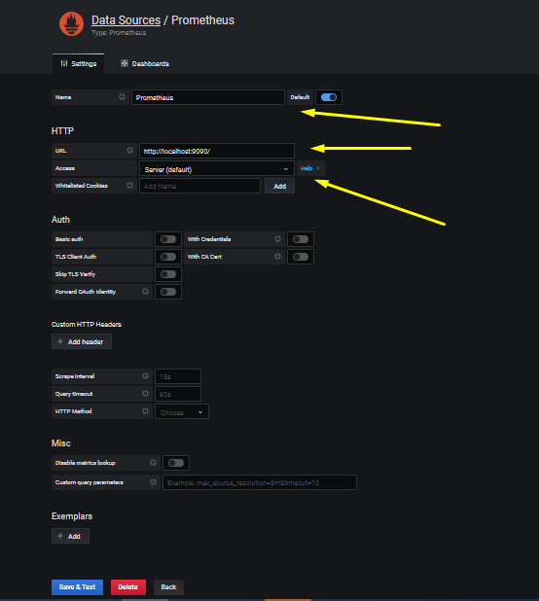
Add Data Source...

Slide 9
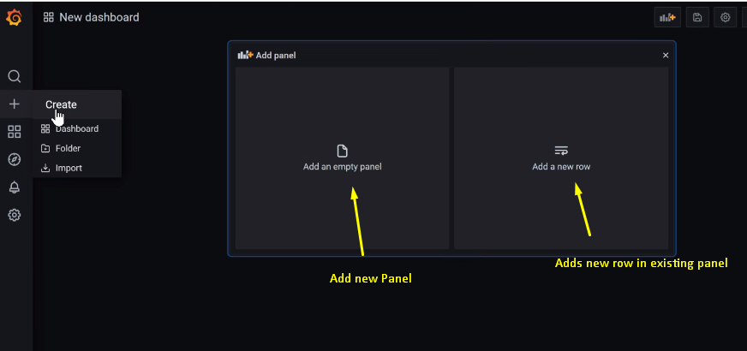
Create Dashboard
One can create Dashboard from UI by Clicking + then Create and it will Ask to add a new Panel as below and Click on Add new Panel
Click to add new panel

Slide 10
Add Panel
Add Panel has various configuration regarding metrics,query,interval etc

Slide 11
Metrics With PromQL
count(up{job="node"}) by (env)
To Count Numer of Nodes
avg(scrape_duration_seconds)
To show avg of scrape duration in seconds
count(up == 1) / count(up)
To show out number of job up in percentage
sum(kube_job_status_active{namespace=~"$namespace"})
To total number of active job
sum(kube_pod_container_status_running{namespace=~"$namespace"})
To show total number of container running
sum(kube_node_status_condition{condition="OutOfDisk", node=~"$node", status="true"})
To show number of node outof Disk

Slide 12
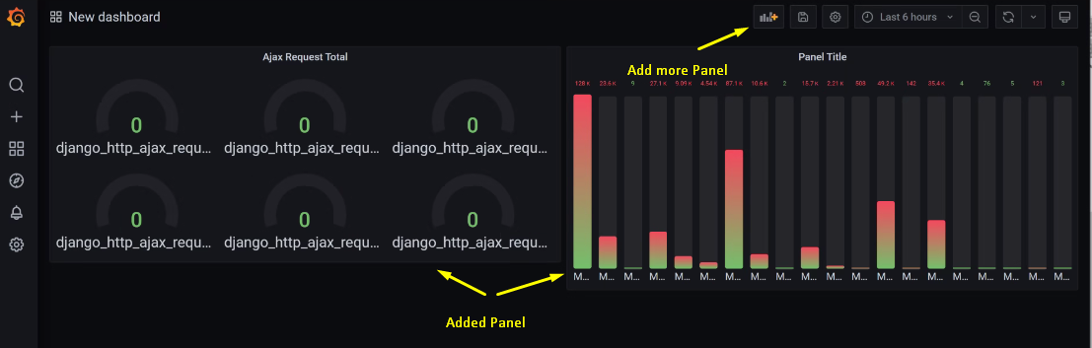
Dashboard View
After Adding Panel Dashboard will looks like as below

Slide 13
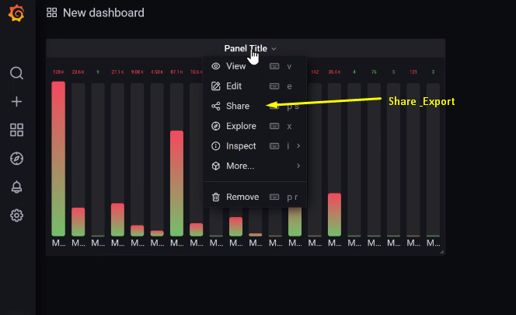
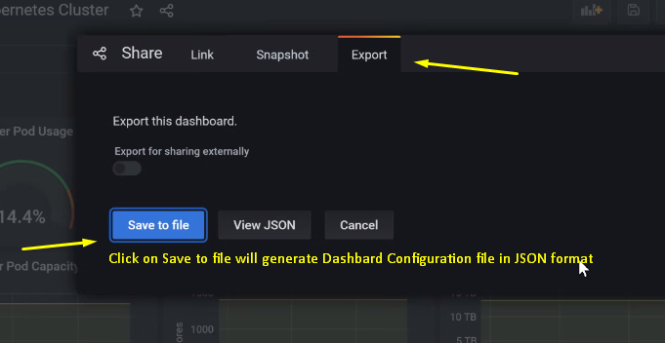
Export Dashboard
Open any Dashbard
Share
Export

Slide 14
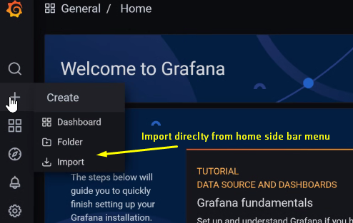
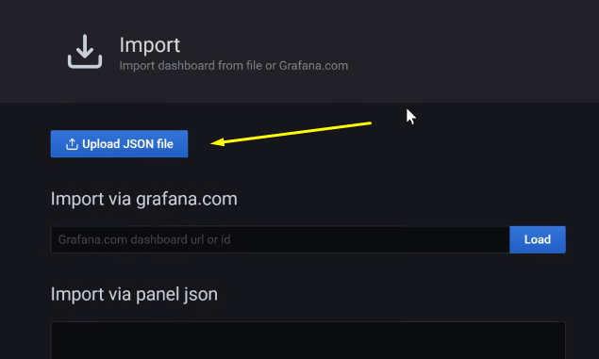
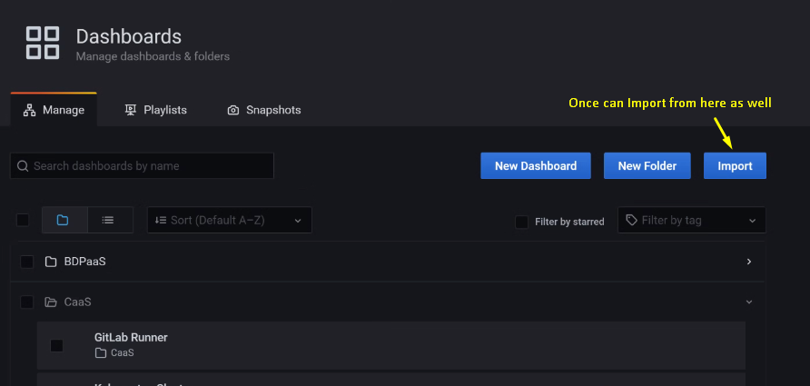
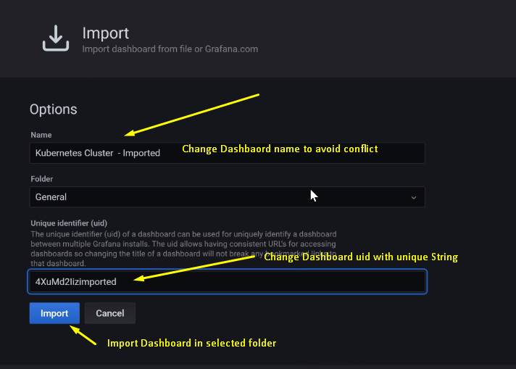
Import Dashboard
Home
Menu
Import
Open Imported Dashboard

Slide 15
Thank you

